Slide 1
Disjoint Sets Prepared by Dr. N. Subhash Chandra from Web resources and Computer Algorithms by Horowitz Sahni
UNIT-III

Slide 2
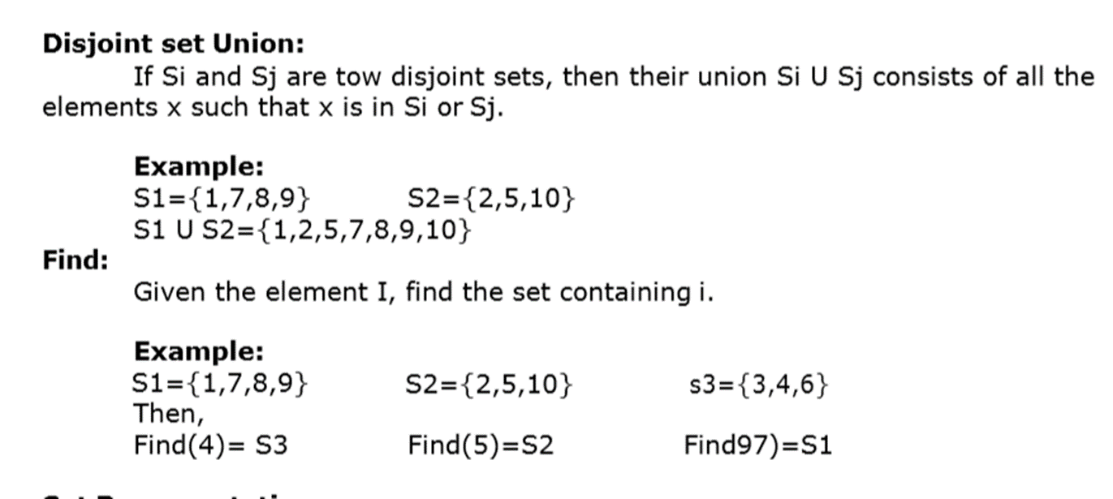
Disjoint Set Operations
Set:
A set is a collection of distinct elements. The Set can be represented, for examples, as S1={1,2,5,10}.
Disjoint Sets: The disjoints sets are those do not have any common element. For example S1={1,7,8,9} and S2={2,5,10}, then we can say that S1 and S2 are two disjoint sets.
Disjoint Set Operations: The disjoint set operations are
Union
Find

Slide 3
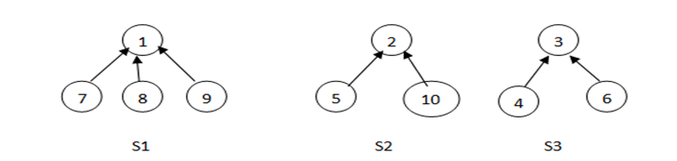
Set representation
Set Representation: The set will be represented as the tree structure where all children will store the address of parent / root node. The root node will store null at the place of parent address. In the given set of elements any element can be selected as the root node, generally we select the first node as the root node.
Example: S1={1,7,8,9} S2={2,5,10} s3={3,4,6} Then these sets can be represented as

Slide 4
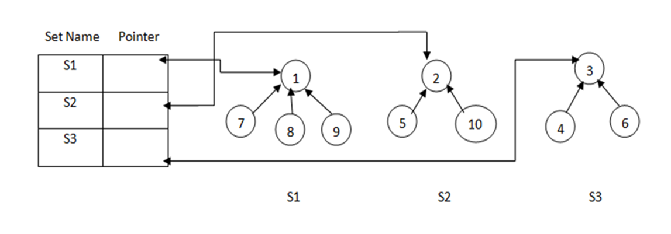
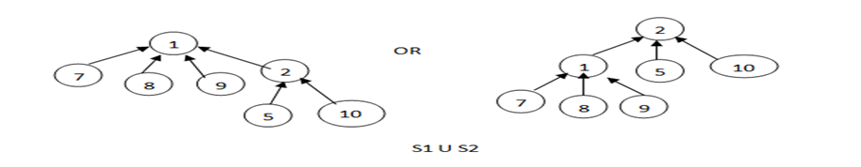
Disjoint Union, Find()
Disjoint Union: To perform disjoint set union between two sets Si and Sj can take any one root and make it sub-tree of the other. Consider the above example sets S1 and S2 then the union of S1 and S2 can be represented as any one of the following.
To perform find operation, along with the tree structure we need to maintain the name of each set. So, we require one more data structure to store the set names. The data structure contains two fields. One is the set name and the other one is the pointer to root.

Slide 5
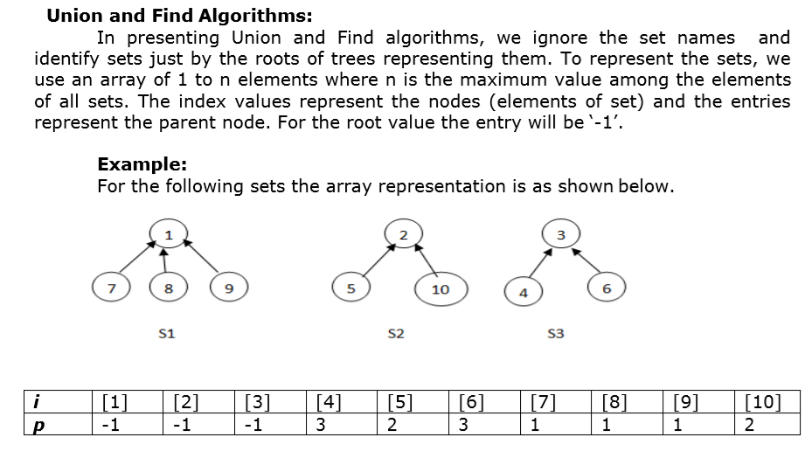
Union and Find Algorithms

Slide 6
Union and Find Algorithms

Slide 7
Union and Find Algorithms

Slide 8
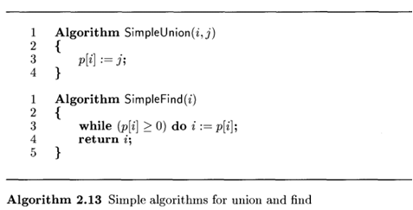
Union and Find Algorithms

Slide 9
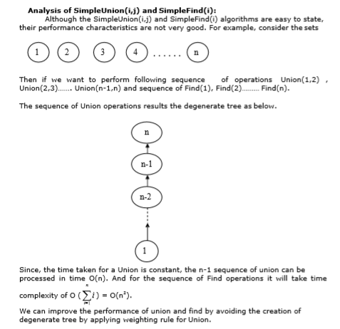
Analysis of simple Union, Find

Slide 10

Weighting rule for Union()

Slide 11
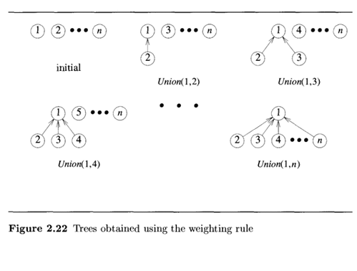
Example Weighing rule

Slide 12
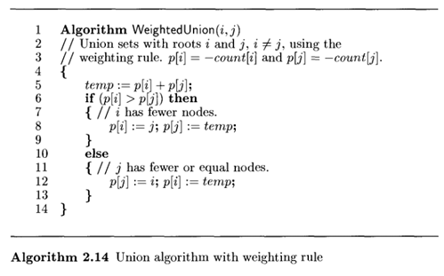
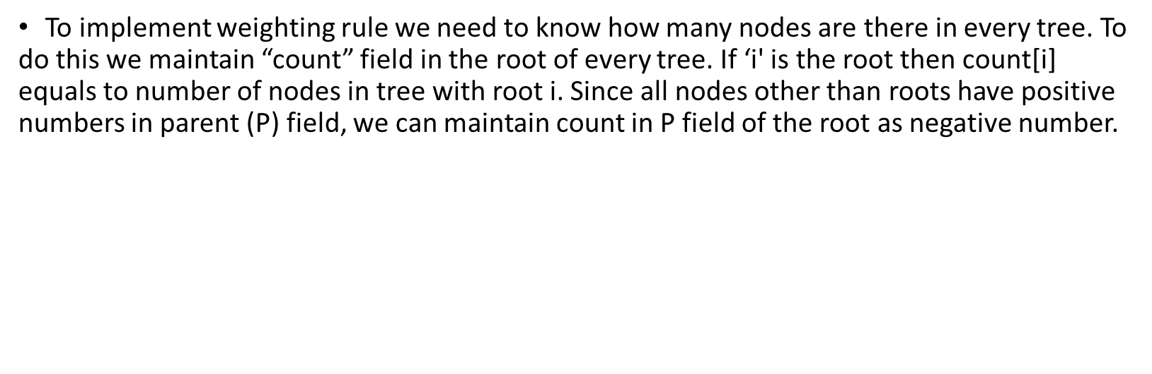
Weighted Union algorithm

Slide 13

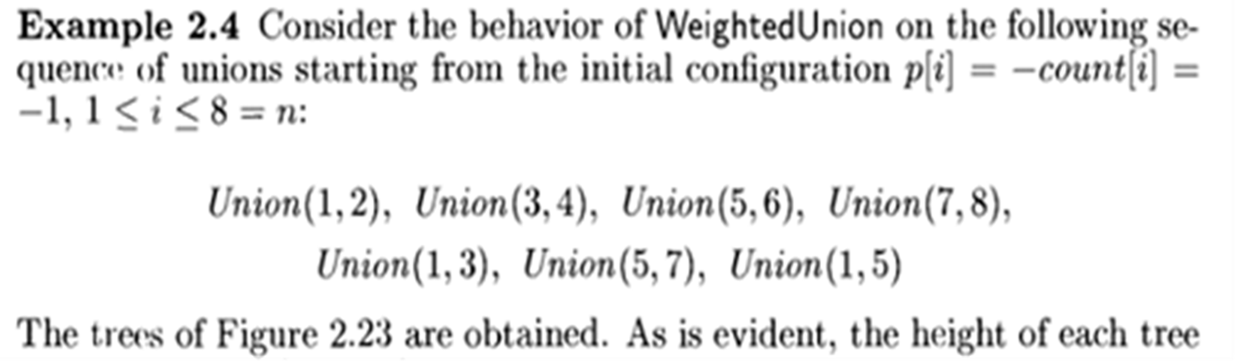
Collapsing rule for Find Algorithm

Slide 14
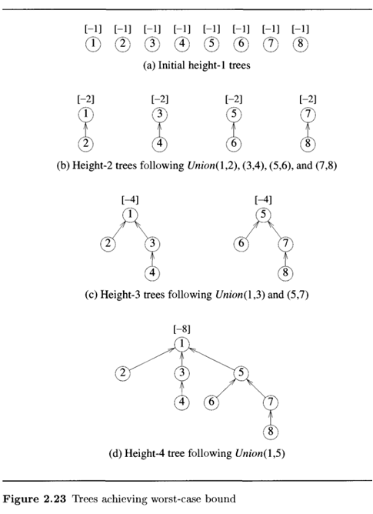

Slide 15
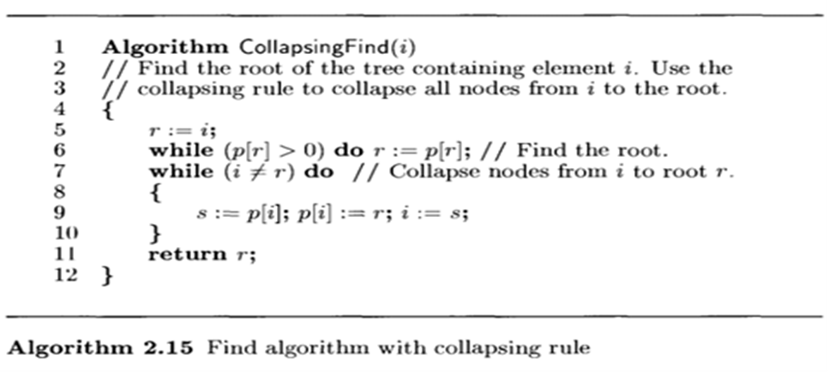
Collapsing find() Algorithm
Analysis:
Now process the following eight find operations
Find(8), Find(8)………………………Find(8)
If Simple Find() is used each Find(8) requires going up three parent link fields for a total of 24 moves . When Collapsing find is used the first Find(8) requires going up three links and resetting three links. Each of remaining seven finds require going up only one link field. Then the total cost is now only 13 moves.( 3 going up + 3 resets + 7 remaining finds).

